Slide 1

Data Analysis of
Chicago Public Schools'
Progress Report Cards
KMVC
January 2019

Slide 2
Presentation Summary
The Data
Project Problem
Data Wrangling
Data Visualizations
Predictive Modelling
Recommendations

Slide 3
About the Data
The data was found on the city of Chicago's website (data.cityofchicago.org)
The data sets comprised 3 report cards for the schools within the Chicago Public Schools (CPS) district from 2014, 2015 and 2016

Slide 4
About the Data (cont)
Each progress report card contains:
  Statistics on student and teacher attendance at each school
  Percentiles attained by the schools in every grade for math and reading (scoring a 50 means the school is average, on a national scale)
  Safety Ratings, Health Ratings and School
  Locations
  School scores on the 5Essentials

Slide 5
About the Data (cont)
What are the 5Essentials?
Effective Leadership
Ambitious Instruction
Collaborative Teachers
Family Involvement
Supportive Environment

Slide 6
About the Data (cont)
UChicago Impact, which implements the surveys conducted to collect the information used for the reports, states that:
“Researchers have found that schools strong on at least three of the five essentials were 10 times more likely to show substantial gains in student learning over time than schools weak on three or more of the five essentials.
Research also shows that a persistently low score in even just one of the five essentials reduced the likelihood of improvement to less than 10 percent”
(https://uchicagoimpact.org/our-offerings/5essentials)

Slide 7
An Issue...
UChicago Impact states that the predictive power of the 5Essentials needs to be viewed in the long-term – about a 10 year range
But changes to education policy means that the metrics collected for the surveys change, and aren't comparable
This meant that I could only try to predict outcomes over a 2 year period

Slide 8
The Problem
The progress reports have been built with a prediction in mind (strength in 3 or more of the 5Essentials leads to improved learning outcomes over time).
So this project's problem was:
Assess whether academic outcomes (2016 Grade 3 Reading and 2016 Grade 3 Math were the specific outcomes selected for this project) could be predicted using the 5Essentials scores

Slide 9
Data Wrangling (cleaning the data)
Main tasks included:
Adding in demographic data to the data (language, population, income, race, gender, etc.)
Joining the 3 different progress report cards (from 2014, 2015 and 2016) into 1 data set
General tidying up of the data
The bulk of the variables were kept from the 2014 set, as these would be used to predict the 2016 outcome variables

Slide 10
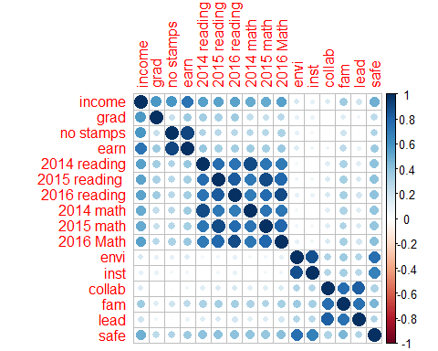
Data Visualizations
A correlation plot (it shows the variables in the data set and their levels of correlation with each other (the bigger and darker the circle, the stronger the correlation between the variables)

Slide 11
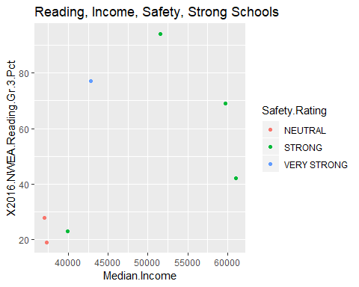
Data Visualization (cont)
A plot of schools that scored “strong” on all 5Essentials, their incomes, 2016 reading percentiles and safety ratings

Slide 12
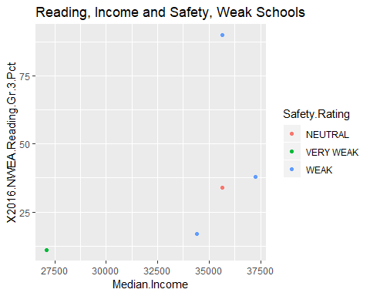
Data Visualization (cont)
A plot of schools that scored “weak” on all 5Essentials, their incomes, 2016 reading percentiles and safety ratings

Slide 13
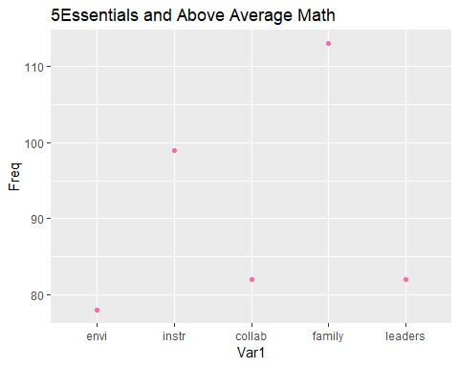
Data Visualization
A plot showing the frequency of each 5Essential being scored as “strong” or “very strong” for schools who attained above the 50th percentile in Grade 3 math in 2016:

Slide 14
Data Visualization (cont)
A few things that can be seen from these plots:
The 5Essentials are rather weakly correlated with the outcome variables
Percentile Attainment variables from previous years (and the same year) have the strongest correlation with the outcome variable
Schools that scored strong on all 5Essentials tended to come from areas with higher income brackets, they had stronger safety rating and had some higher academic outcomes than schools that scored weak on all 5Essentials
For schools that scored above average in math and reading, Family Involvement was the Essential most frequently scored strong or very strong

Slide 15
Predictive Modelling
For both outcome variables, the modelling techniques chosen were Random Forest and Gradient Boosting
I also made models from data sets that removed all percentile variables, to see how much weaker the models would be if they depended mostly on demographic data and the 5Essentials

Slide 16
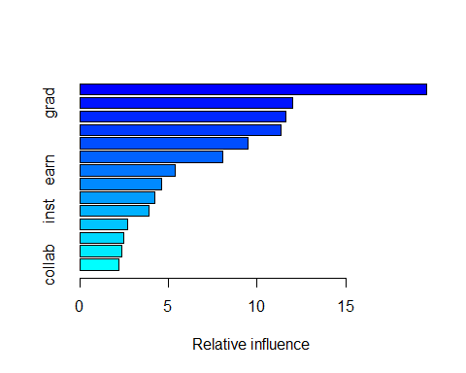
Gradient Boosting Model
A plot of the relative influence of each variable on the model (for reading 2016) (graduation seems to have the highest relative influence)

Slide 17
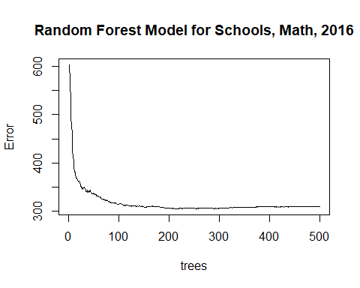
Random Forest Model
The Random Forest Model for Math 2016, showing how error drops as the number of trees increases

Slide 18
Predictive Modelling
For regression models, one of the main ways to evaluate a model is to look at its RMSE (the lower, the better)
The lowest RMSEs for the models trained for this project was the Random Forest models (for both Math and Reading)

Slide 19
Predictive Modelling
However, for the models trained without the percentile variables from previous years, the RMSEs were substantially higher (they were less accurate)
This means that academic outcomes were more accurately predicted (lowered error) when previous academic outcomes were included, and the 5Essentials were not effective for accurately predicting academic outcomes on their own (and even with the help of some added demographic data

Slide 20
Recommendations
What does this mean?
1) Lobby for education policy to take a long-term perspective
2) Focus on family involvement
3) Think about adding in more data

Slide 21
Recommenations (cont)
Lobby for education policy to take a long-term perspective
The predictive power of the 5Essentials did not seem to be strong, from this project's exploration. However, the project could not properly assess the 5Essentials on the terms set by Uchicago Impact, because they need to be assessed against a ten year range of academic outcomes (and changing educational policy meant changing metrics)
Therefore: lobby government to think about education long-term. Set long-term metrics that get a long-term commitment, so that education policy in Chicago can be data-driven and the effectiveness of the 5Essentials can be fully assessed.

Slide 22
Recommedations (cont)
Focus on family involvement
Schools scoring above the national average in math and reading had “Involved Family” as the 5Essential they most frequently scored “strong” or “very strong” on.
Therefore: Continue to focus on cultivating strong relationships with students' families and think of ways to further involve families in their children's educational development

Slide 23
Recommendations
Add in more data
The progress report cards contained some significant data. But there is other data that schools should be compiling, whose addition to the data set would provide a more full picture of schools in Chicago and perhaps increase predictive accuracy.
Therefore: Add relevant data to the data set, such as student failure rate, teacher turnover, and the average ratio of teachers to students in classes.

Slide 24
For more information
To see a more detailed report on this project, you can click here.

